Slide 1
Big Data- Python/Spark
Batch Name : 210628 - Chennai - Python Spark

Slide 2
Use Case Description
Real-Time Analytics using Apache Kafka, Zookeeper, PySpark. Analyzing the real time RSVP data of meetup.com to get real-time insights such as trending topics, cities etc. along with other business insights related to Meetups RSVPs. The data processing scripts are developed in Python.
Problem Statement :
What are the current active cities in the US which are scheduling Meetup Events?
What are the trending topics in US Meetup Events?

Slide 3
The Goal of Analysis
Real-Time Analysis means that you can immediately process and query new data as it is created to inform decisions in the moment and guide your business decision making.
Advantages of real-time analysis:
Data Visualization
Business Insights
Increased Competitiveness
We are analyzing the real time RSVP data of meetup.com to get real-time insights such as trending topics, cities etc. along with other business insights related to Meetups RSVPs.
With this, the businesses will know the most trending topics and build more effective relationships among the events.

Slide 4
Tech Stack and Configuration
Spark [3.1.2]
Kafka [2.8.0]
PySpark [2.4.8]
Python [3.6]
ETL: Spark DataFrame, Spark Structured Streaming
Visualization: matplotlib [3.4.3]
Git/GitHub

Slide 5
Methodology
Created Kafka producer and published data to Kafka topic.
Used the WebSocket in Python to get data from the source.
Setup Spark and Kafka environments to run PySpark driver and python-kafka driver into the program.
Ran Spark SQL queries to filter out data from Spark SQL tables and stored it into kafka topics.
Consumed output data from Kafka and plotted data using Matplotlib.
Utilized version control through Git and Github.

Slide 6
Retrieving Data
Create a meetup account.
https://stream.meetup.com/2/rsvps
We retrieved the data from the above link by creating a web socket.

Slide 7
Kafka in Streaming
Kafka combines three key capabilities so you can implement use cases for event streaming end-to-end with a single battle-tested solution:
To publish (write) and subscribe to (read) streams of events, including continuous import/export of your data from other systems.
To store streams of events durably and reliably for as long as you want.
To process streams of events as they occur or retrospectively.

Slide 8
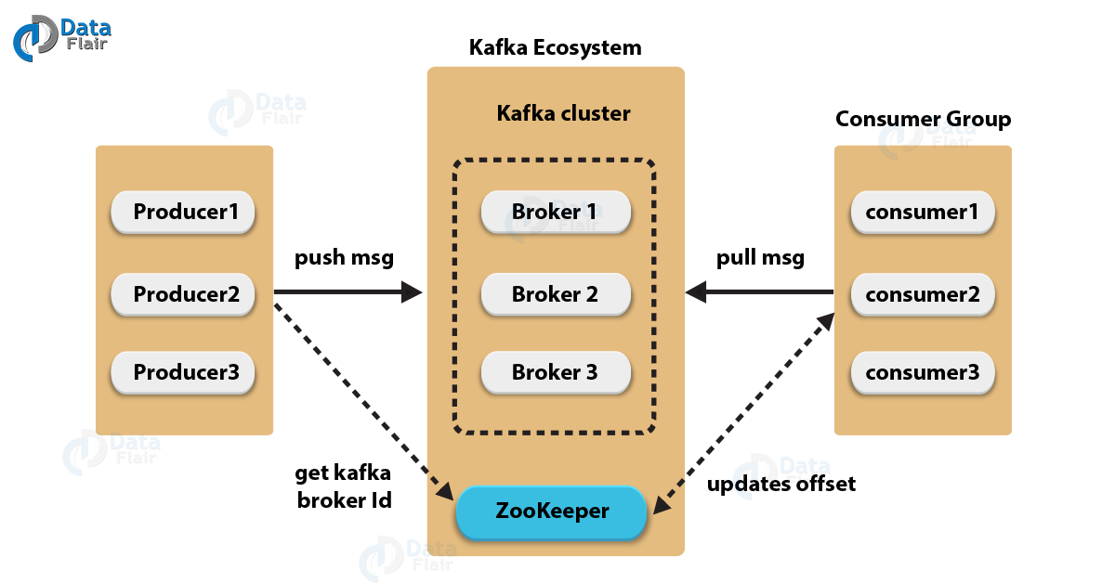
Apache Kafka Producer/Consumer
Producer API:
In order to publish a stream of records to one or more Kafka topics, the Producer API allows an application.
Consumer API:
This API permits an application to subscribe to one or more topics and also to process the stream of records produced to them.

Slide 9
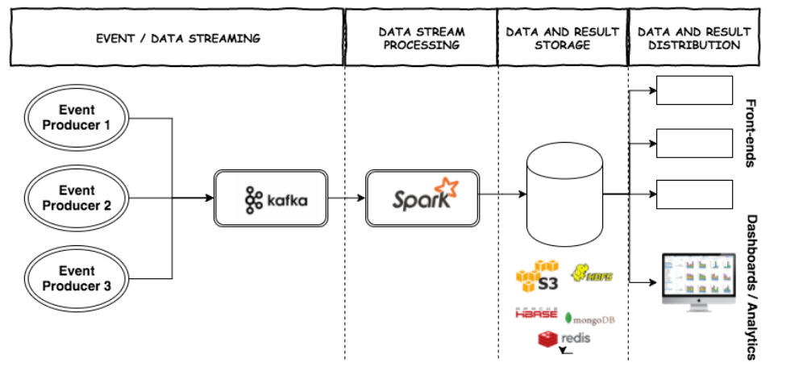
Processing and Analyzing Data
Working of Kafka with spark streaming :
kafka

Slide 10
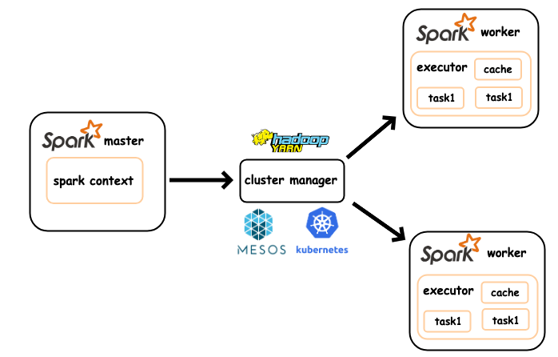
Spark Application Programming
Apache Spark Architecture is based on two main abstractions:
Resilient Distributed Dataset (RDD)
Directed Acyclic Graph (DAG)
In Spark, we mainly have Spark Context and Spark Session.

Slide 11
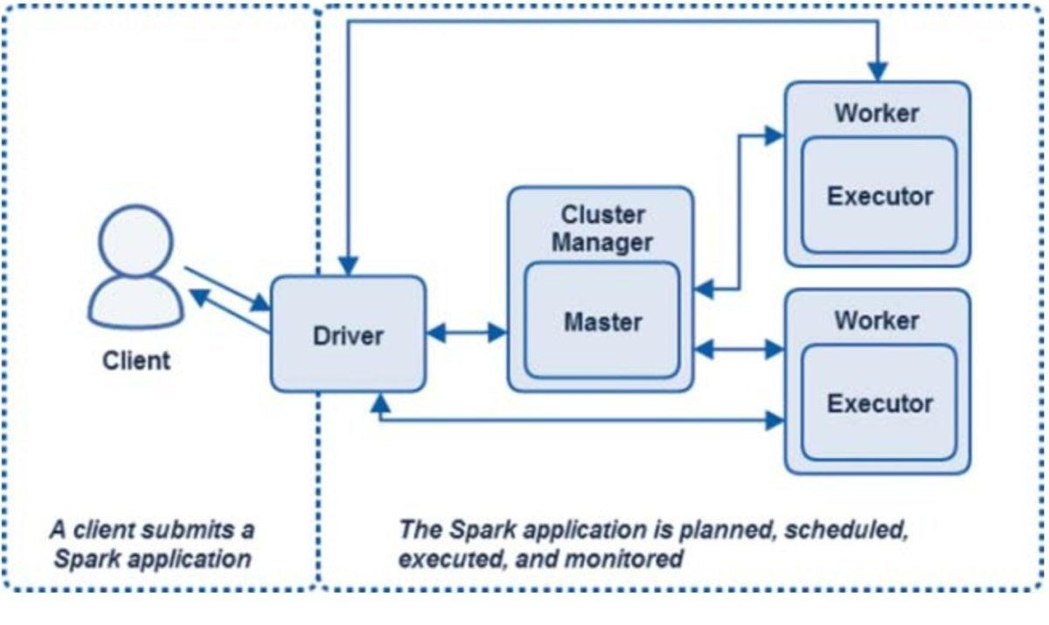
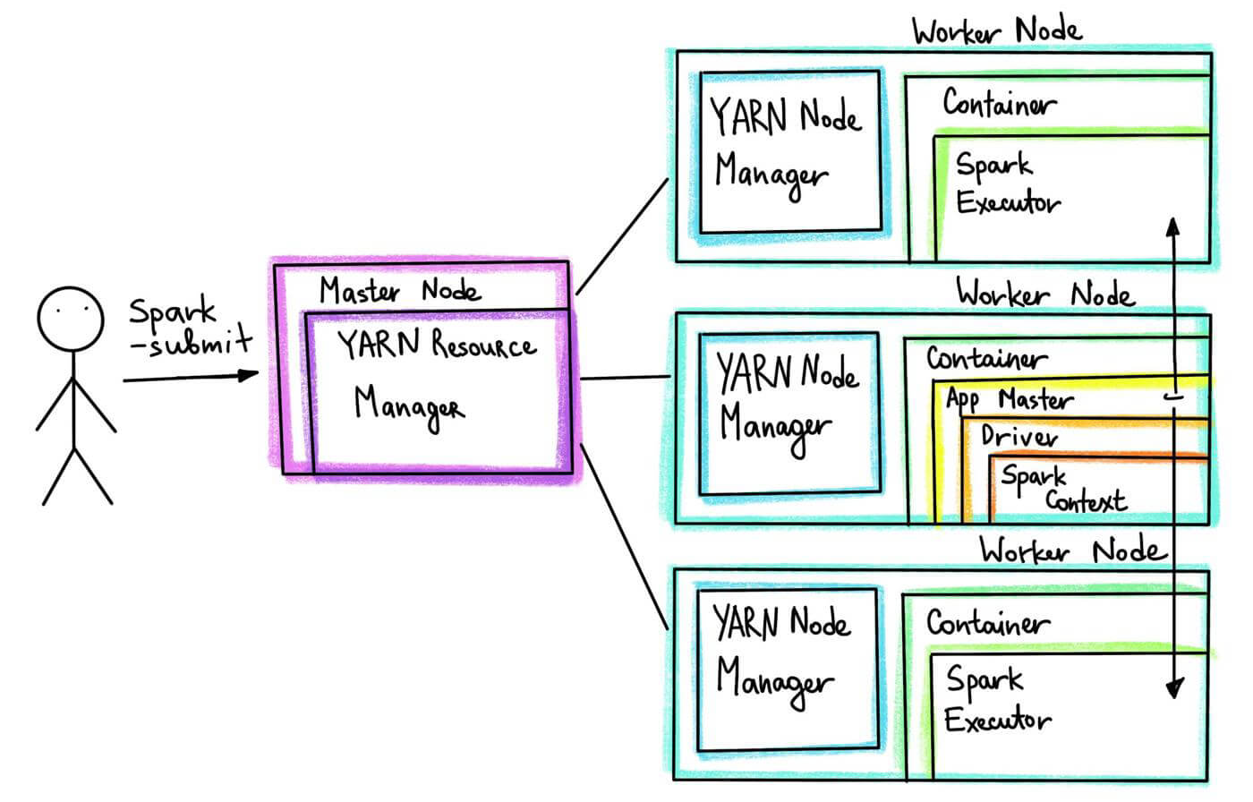
Submitting the Spark Application
Start Consumer.py to consume the stream from the '''meetup''' topic
Submit the spark job spark_meetup.py, to read the data into Spark Streaming
from Kafka.
.bin/spark-submit --packages org.apache.spark:spark-streaming-kafka-0-10_
2.12:3.1.2 spark_meetup.py localhost:2181 meetup

Slide 12
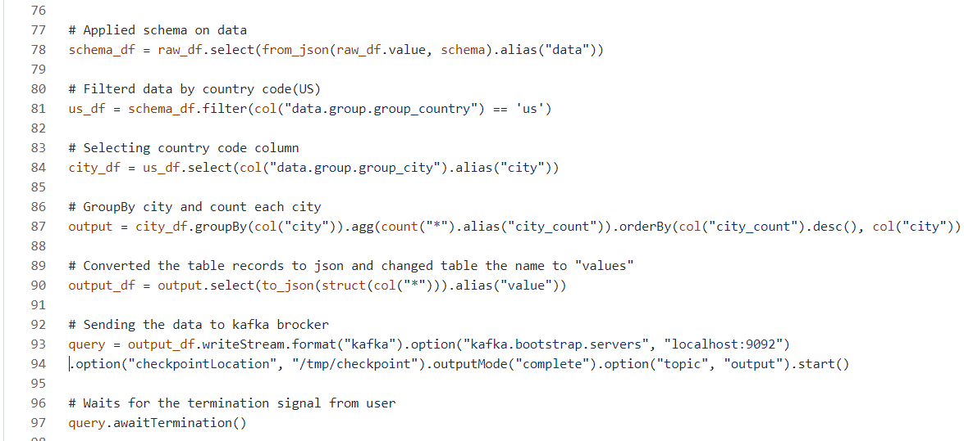
Code Walk-through
What are the current active cities in the US which are scheduling Meetup Events?
https://github.com/Sailash/Project_3/tree/main/activeCities

Slide 13
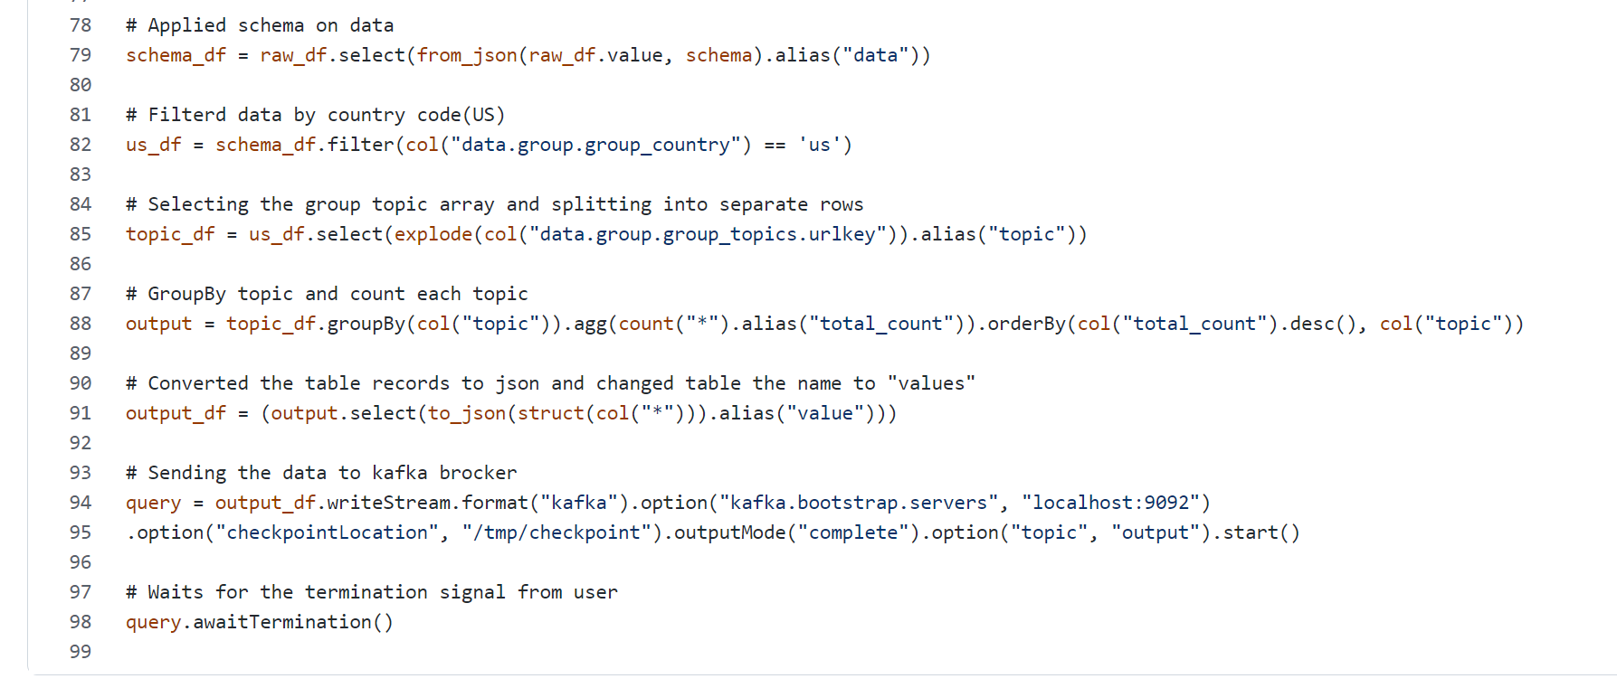
Code Walk-through
What are the trending topics in US Meetup Events?
https://github.com/MANASWINI1591/BIG_DATA_PROJECT_3

Slide 14
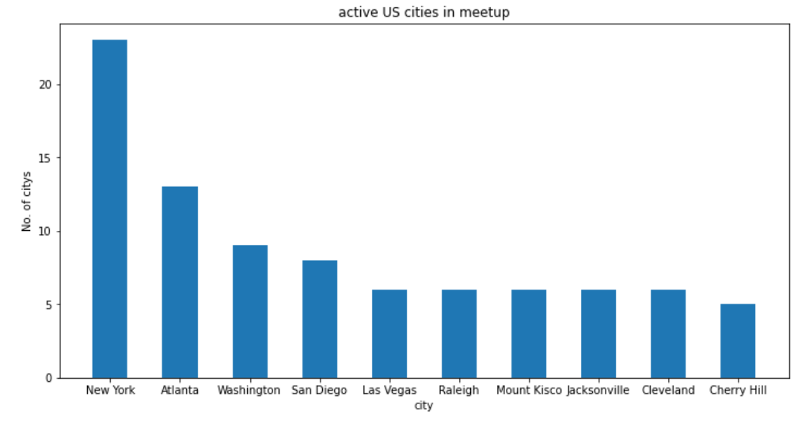
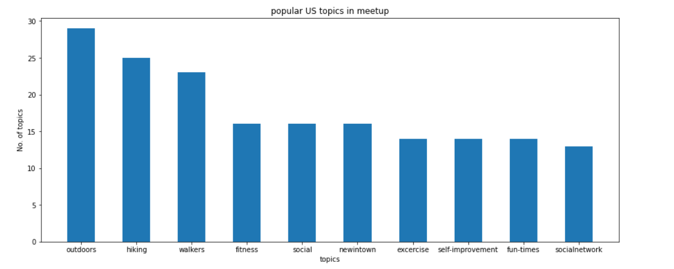
Data Visualization
Visualize the data using Bar chart

Slide 15
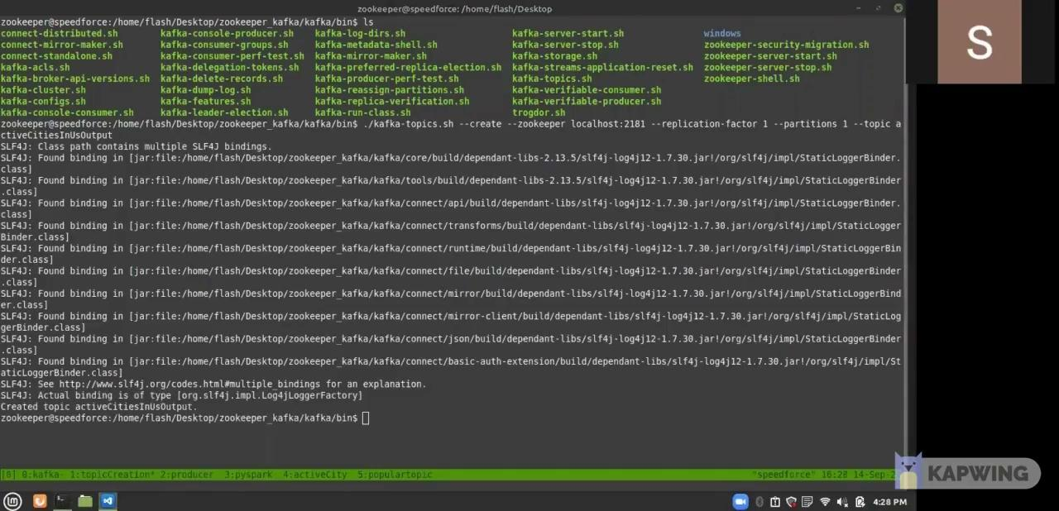
Demo Video
Working Flow of Project

Slide 16
Tech Challenges
We got dependencies error while connecting kafka with spark → such issues arise like “Please deploy the application as per the deployment section of Structured Streaming + Kafka Integration Guide"”.
At initial stages we faced difficulties while Structuring the schema of streaming data.
After completed the operations, we faced difficulties while sending back data to kafka topic.
Kafka server disconnected many times.

Slide 17
Tech Solution
We sorted out the dependencies error by changing the current version of kafka and pyspark with stable version.
We created the structured schema for nested document streaming data (json file).
We used write and read stream methods of spark structure streaming that solved our problem to store the data back to output topic.
We used the kafka-server-stop script to stop the server and restarted again.

Slide 18
Business Solution
Minimizing preventable losses
Streaming analytics prevents or minimizes any damage caused by events such as security branches, manufacturing defects, customer churn etc.
Analyzing routine business operations
Operations such as IT systems, financial transactions such as authentications and validations can be monitored in real time.
Finding missed opportunities
Streaming and analysis of big data can help businesses as well as immediately recommend, upsell based on what information presents.
Create new opportunities
Existence of streaming data technology has resulted in the invention of new business models, product innovations and revenue streams.

Slide 19
Take from the project
We got to know how companies deal with real time data processing.
Our understanding of Kafka and Spark Streaming were enhanced by working with them.
We understood how to deal with various errors that may arise during a Kafka project.

Slide 20
Future Enhancements
This project can be extended to get the real time trending topics across the world or for a specific geographical location along with other business insights.
By giving real time trends in topics like in twitter, users of meetup will be aware of more and less popular topics in near real time.
With minor modifications, this project can also be extended to process and analyze IoT data.

Slide 21
Conclusion
Through this project we were able to successfully find out the answers to some of the basic data analysis questions that one can have regarding Meetups. These insights can be useful in increasing revenue significantly. Now let’s try to analyze that why did we get the output that we got.
For the first question regarding active US cities i.e. the cities that are scheduling meetups, we got mostly the west-coast cities topping the list. That's because being wealthier than the east-coast cities, people there have more leisure time. New York was the exception there, being the business hub of US.
For the second question regarding trending topics in US, topics related to outdoor activities topped the list. That's because people have spent enough time indoors, all because of the current COVID pandemic.

Slide 22
GitHub & References
GitHub repo : https://github.com/Sailash/Project_3
References:
https://mvnrepository.com/artifact/org.apache.spark/spark-streaming-kafka-0-10_2.12/3.1.2)
http://spark.apache.org/docs/latest/streaming-kafka-integration.html
https://stream.meetup.com/2/rsvps

Slide 23


Thank You
Revature.com

